Slide 1
Porsche EV Marketing Analytics
Data Ghosts
Sanjay Jain - srajkumarjain1@student.gsu.edu
Shashank Goswami - sgoswami7@student.gsu.edu
Jennifer S. Johnson - jstanjohn@gmail.com
Patrick Hackett - patrick.d.hackett@gmail.com

Slide 2

Business Deliverables
Where to build which charging stations and why?
What customers are likely to buy which EVs, which ones aren’t?
Who should we market to, what kind of cars, and where?

Slide 3
1. Where to build which charging stations and why?
What we will deliver:
Prioritized ranking by Return on Investment (ROI) of each charging station type with product components, type of location it would be installed (e.g., corporate offices, hotels, stores, gas stations), and in which zip code.
Example deliverable
Charging Type | Location Type | White Glove/ Elite Service | Zip Code | Quantity | Charging Time | Connectors | ROI
Level 2 | Supermarket | Yes | 30316 | 5 | 2 - 8 hrs | SAE J1772 | 40-50 customers per day
Level 2 | Mall | Yes | 30324 | 15-20 | 2 - 8 hrs | SAE J1772 | 500-1000 customers per day
Level 2 | Amusement parks | Yes | 30349 | 15-20 | 2 - 8 hrs | SAE J1772 | 500-1000 customers per day
Level 3 | Government Office and Buildings | No | 30301 | 4-5 | 0.5-1 hr | CCS connector | 100-150 customers per day
Notes:
Government plays an important role in making it compulsory for each facility to have a minimum amount of car chargers. Such as a law passed in atlanta, georgia.
White glove service. ROI subjective, due to driver comfort

Slide 4
1. How we will deliver charging station recommendations:
Using the following data:
Quantitative
• Last used (by car type)
• Hours of operation
• Population
• Proximity to major city, shopping, work, industrial area
• EV car # to charger # proportion per zip code
• Chargepoint API
Qualitative
• Geographical location of existing EV charging stations
• EV charging types:
• Level 1
• Level 2
• Level 3/DC Fast Chargers
• Customer feedback on charger types and preferences
We will use the following modeling approach:
Using current data on number of EV owners per zip code compared to locations of publicly available charging stations in conjunction with chargepoint data on waiting lines, we will simulate charging station placement to minimize wait lines for EV users in high traffic areas.
Simulation results will be used in conjunction with Q2 location clusters for zipcodes most likely to purchase target Porsche models to create a linear optimization model to increase availability in target regions while taking into account cost constraints.
Charging preferences by consumers will be regressed against specific location types to add additional weights to the optimization model and specify types of locations/buildings within a zip code to target.
Notes:
Discuss scalability – data can automatically flow from source to model to output in dashboard with daily refresh to be viewed and consumed by on the ground business at Porsche for decision making.

Slide 5

2. For any given customer, what is the likelihood of them buying/not buying a type of car?
What we will deliver:
Market segmentation into customer segments with associated demographic, household, location information and associated probabilities of buying each type of model with associated features to give final recommended “model types and ranges per persona”
Customer Segments | Pragmatists | Risk Takers | Upwardly Mobile | Near-Retirees
Age Range (years) | 28-40 | 25-35 | 42-53 | 50-65
Demographics | Female Advanced Degree | Male Project Manager | Senior Executive Home value > $400k | Self-Employed Online Sales
Zip Codes | 30064, 30332, 30080, 30062 | 90210, 94506, 94027, 12345 | 64014, 73170, 63026, 33496 | 85253, 21056, 86366, 68520
Probability of purchasing EV (by model) | BMW i3 (44%) Nissan LEAF (27%) Tesla Model 3 (16%) | Tesla Model S (52%) Tesla Model X (41%) Jaguar I-PACE (9%) | Tesla Model S (62%) Jaguar I-PACE (6%) | Tesla Model X (60%) Tesla Model S Long Range (32%)
Notes:
NOTE: Based on my research, it’s more appropriate to call these customer segments rather than personas. JSJ
https://www.acquia.com/blog/creating-personas-vs-customer-segments-whats-difference

Slide 6
2. How we will deliver customer segments:
Using the following demographic data:
Quantitative
• Demographics of Electric vehicles consumer of each state by Age, income(dual-income), gender, location, profession, industry, degree
• Type of vehicle like SUV, Sedan or Hatchback and its price, Type of Home.
• Same Demographics above of Consumers having gasoline cars above $100k to understand the buying trends and factors.
Qualitative
• Each state's regulation policies and laws (Tax-Rebates).
• Social media analysis of Reviews of EV to understand behavioral trends.
We will use the following modeling approach:
Segmenting customers using K-means, we can build a classifier model in each segment to determine the probability of a customer buying the vehicle or not.
Notes:
Discuss scalability – data can automatically flow from source to model to output in dashboard with daily refresh to be viewed and consumed by on the ground business at Porsche for decision making.

Slide 7
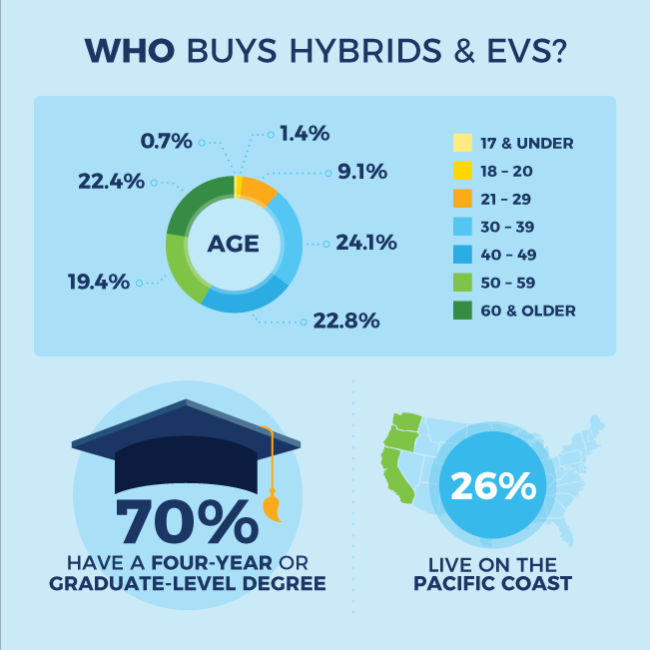
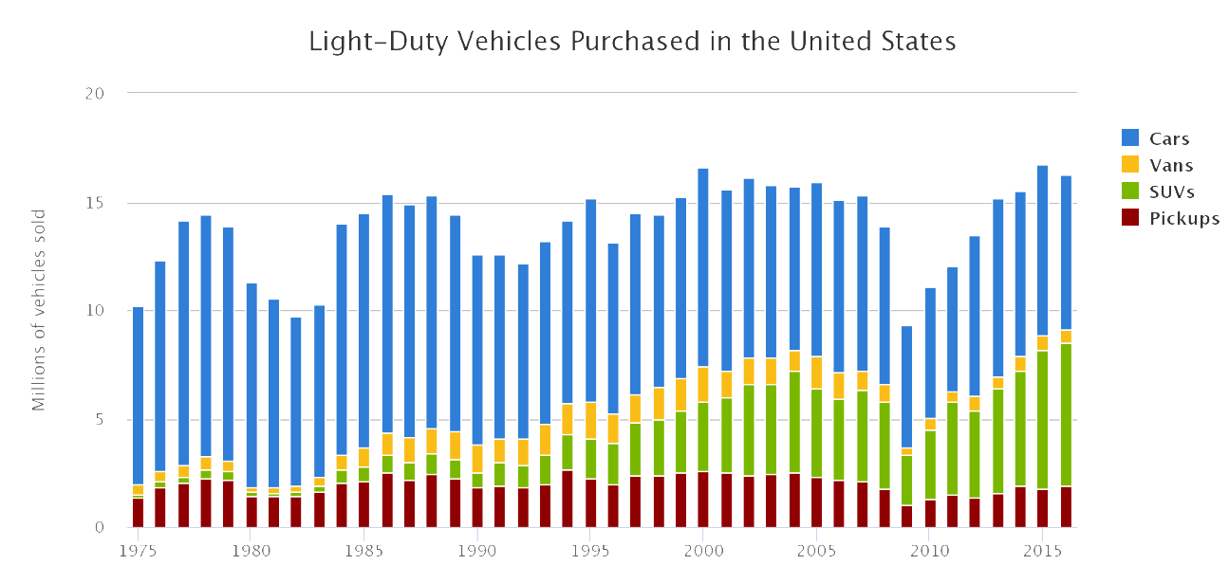
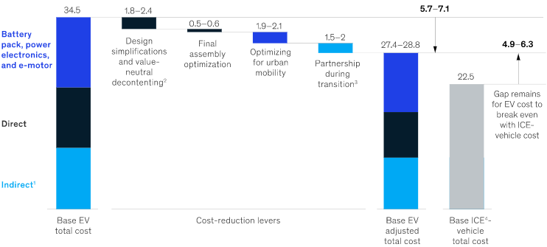
3. What kind of cars should be marketed to who and where?
What we will deliver:
Per car, which persona it should be marketed to in which manner to which region, ranked by probability of opportunity and number of expected sales.
Visualization of marketing guidance:
Notes:
Note: See table on slide 10 also

Slide 8
3. How we will suggest marketing recommendations:
Using the following data:
Quantitative
•Demography of each state by Age, income(dual-income), gender, location(zip-code,rural,urban) , profession, industry, degree(very important)...
•Type of vehicle like gasoline, hybrid and which kind of vehicle like suv, sedan
•Price of vehicle
•Persona clusters and data defined in response to question 2.
•Marketing campaign data w/ sales trends
Qualitative
•Each state's regulation policies and laws
•Persona clusters and data defined in response to question
We will use the following modeling approach:
Using decision tree algorithms based on EV features, we will be able to pair any EV build and cost to our persona clusters, and provide a breakdown of marketing dollar spend for each customer group and location based on probability of purchase.
Notes:
Discuss scalability – data can automatically flow from source to model to output in dashboard with daily refresh to be viewed and consumed by on the ground business at Porsche for decision making.

Slide 9
Additional Materials

Slide 10
3. What kind of cars should be marketed to who and where?
Example deliverable
Customer Segment | Vehicle Type & Ranked Probability | Marketing & Advertising | % Marketing Budget | Region | Expected Sales
Pragmatists | BMW i3 (44%) Nissan LEAF (27%) Tesla Model 3 (16%) | Online ads including banner ads and social media | Online Ads: 100% | Southeast | $200M
Risk Takers | Tesla Model S (52%) Tesla Model X (41%) Jaguar I-PACE (9%) | Online and Print Ads | Online Ads: 50% Print Ads: 50% | West Northeast | $178M
Upwardly Mobile | Tesla Model S (62%) Jaguar I-PACE (6%) | Online and Print Ads | Online Ads: 35% Print Ads: 65% | Mideast Southeast | $105M
Near-Retirees | Tesla Model X (60%) Tesla Model S Long Range (32%) | Print ads including direct mail, flyers, and ads in magazines and newspapers | Print Ads: 100% | Southeast Midwest | $50M
Notes:
NOTE: Can use this table for Q3 (JSJ)

Slide 11
General Marketing Ideas and Suggestions
•Charging Infrastructure
Invest in chargers in public spaces
Disseminate information on charger locations
•Consumer Awareness
Establish public demonstration of PEVs
Develop a consumer education plan
•Cost Reduction
Alleviate battery ownership risk
Optimizing EV designs – Decontenting, design revision
Collaborating with competitors to reduce R&D, tooling and plants cost.
New Business Models – Battery Leasing and fleet sales

Slide 12
Optimal Strategy
•Favorable Geography
Provide tax incentives for purchase
Invest in chargers in public spaces
•Preferred type
Cars, SUVs occupy major chunk in Light-Duty Vehicles
•Customer Targeting
Advanced degree holders
Household income > $100,000
Access to free charging(Workplace/Public)
Solar PV adoption among PEV owners

Slide 13
Data Sources
Scrape Chargepoint site or use Chargepoint API
https://volttron.readthedocs.io/en/develop/specifications/chargepoint_driver.html
Alternative Fuel Stations
https://developer.nrel.gov/docs/transportation/alt-fuel-stations-v1/
Porsche Taycan Models (Literature Review)
https://www.porsche.com/usa/models/taycan/taycan-models/taycan-turbo/
Charging Up the Porsche Taycan: Fast Charging and More (Literature Review)
https://www.chargepoint.com/blog/charging-porsche-taycan-fast-charging-and-more/

Slide 14
Data Type
1) VEHICLE REGISTRATION of new york
2) vehicle registration of california -
3) vehicle counts of illinois
4)scrapped user reviews of electric vehicle and find out the difficulties they are facing and analyze their sentiments by natural language processing.
Record Type | VIN | Registration Class | City | State | Zip | County | Model Year | Make | Body Type | Fuel Type | Unladen Weight | Maximum Gross Weight | Passengers | Reg Valid Date | Reg Expiration Date | Color | Scofflaw Indicator | Suspension Indicator | Revocation Indicator
Registration Class | ZIP | Model Year | Fuel | Make | Duty | Vehicles

